Slide 1

E-commence Data Analysis
Future Data Analysts

Slide 2


Introduction to Web-Scraping Presentation
Tools used
Libraries Used
- BeautifulSoup
- Request and Json
- Pandas
- Matplotlib and Searborn
-Numpy
Anaconda (Jupiter Notebook)

Slide 3

Phase 1: Web Scraping
1. What is Web-Scraping?
2. Why Web-Scraping?
3. Selected data to analyze
Title
Price
Rating
Availability
Review counts
4. Tools and Technologies
Requests: Fetches HTML content.
BeautifulSoup: Parses and extracts data

Slide 4
Phase 2: Data Cleaning using Pandas lib
Removing missing or duplicate data.
Converting price columns to numerical values.
Normalizing ratings.
Handle outliers.

Slide 5
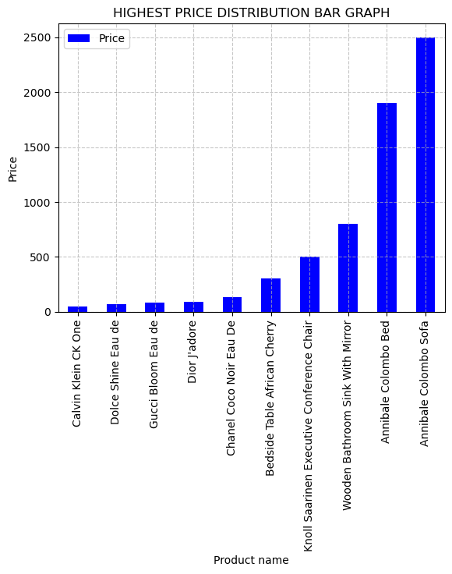
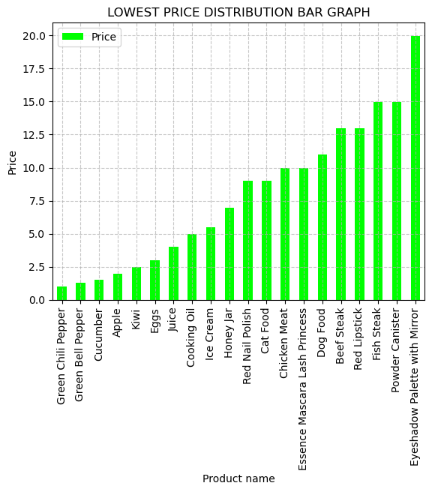

Slide 6
Phase 3: Exploratory Data Analysis
Analyze price distribution.
1
Find top-rated products.
2
Identify price vs. rating correlation.
3
Summarize trends
4

Slide 7
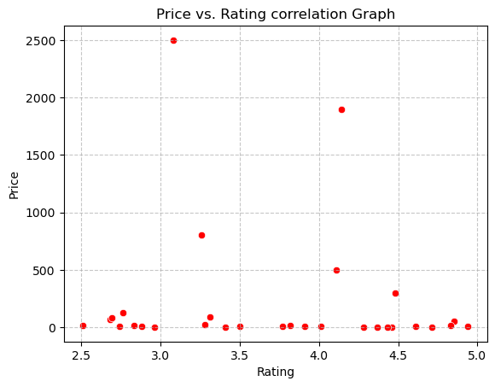
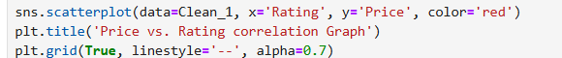
PRICE VS RATING CORRELATION

Slide 8
Phase 4: Insights & Recommendations
Average prices of products
The best-rated products
Seasonal pricing trends
Outliers

Slide 9

Key Findings
Average Product Prices
Top-Rated Products
Best-Rated Price Range
Price vs. Rating Correlation
Seasonal Pricing Trends
Outliers Identified
High-priced outliers
Low-priced outliers

Slide 10

Recommandation
Focus on
High-Value Products
Monitor
Seasonal Trends
Enhance
Product Quality
Address
Outliers
Leverage
Customer Feedback
Optimize
Pricing Strategy

Slide 11

Conclusion
Implementing these insights and recommendations will enhance market positioning, improve customer satisfaction, and drive sales growth in the e-commerce landscape.

Slide 12

Thank you….

